Slide 1


Midlands Healthcare Coalition
Project
Development
A GUIDE TO DEVELOPING AND SUBMITTING A PROJECT PROPOSAL

Slide 2

Outline
Importance of a Well-written Submission
Coalition Project Lifecycle: Project Timeline
Project Proposal Collaborators and Flow
Project Development
Researching the Project
Building the Project Proposal

Slide 3
Importance of a Well-written Submission
  Increased odds of approval
  Ensures consistent focus on priority projects
  Executive Committee voting & prioritization decisions
  Advisory Council/Steering Committee approved projects
  Supports the next Budget Period (BP) Grant Funding application
  Structures Coalition’s approved funding allocation areas
  Contracts, Conferences, Training/Exercise, Maintenance
  Provides data for required financial documents/documentation
  Budget Forms, Contracts, DHEC Purchase Orders

Slide 4
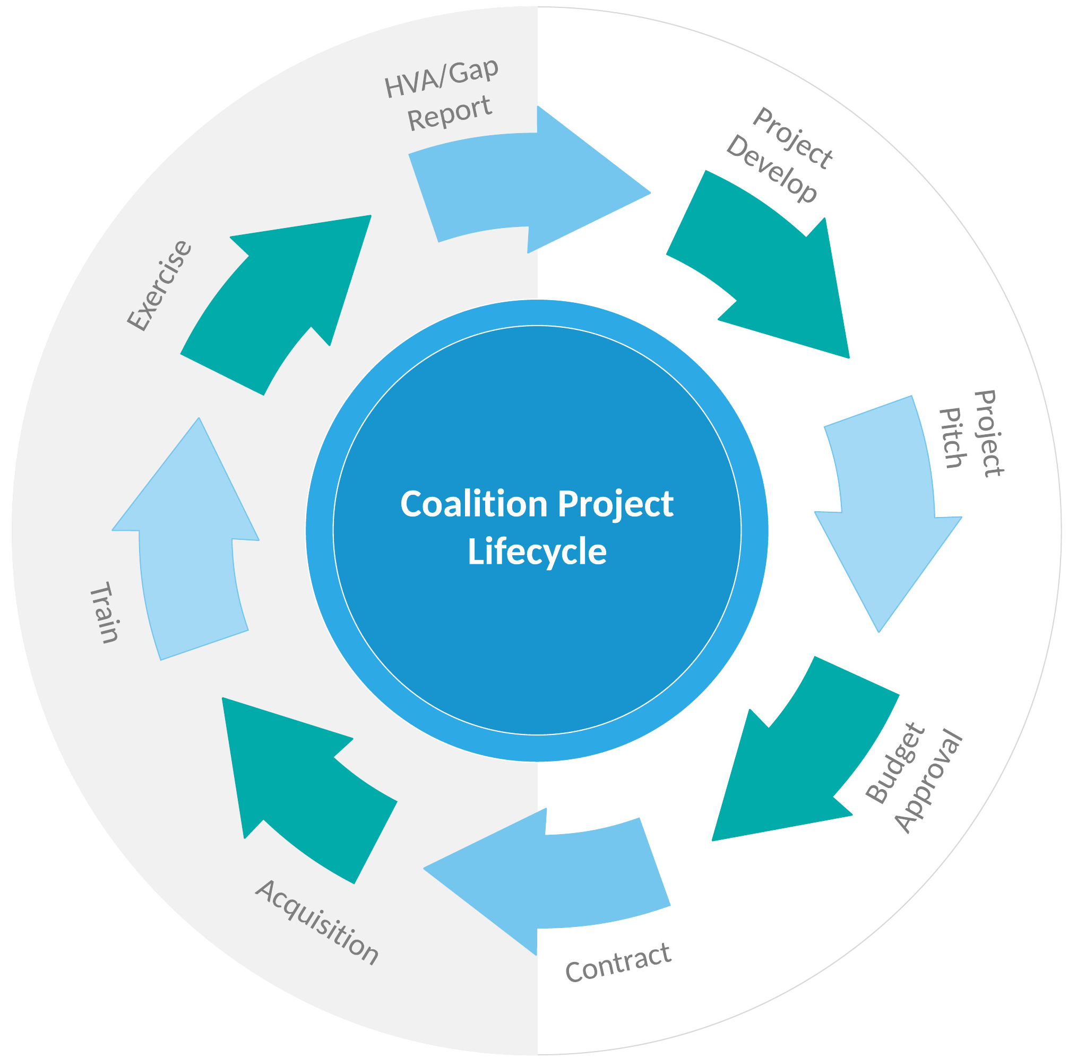
Coalition Project Lifecycle
Notes:
It is always project time, whether it is preparing one, presenting one, managing one, or final implementation training and exercise.

Slide 5
Project Timeline
Q1 (Jul-Sep) | Q2 (Oct-Dec) | Q3 (Jan-Mar) | Q4 (Apr-Jun)
Grant: New BP starts, and current BP projects/workplan begins. Next BP Project Planning begins. | Grant: Contracts for current BP completed and begin call for Next BP Projects. | Grant: Decisions on Project Proposals for Next BP. . | Grant: NOFO application is submitted to ASPR for the Next BP funds. Close out current BP reimbursements.
Member: Next BP Project Planning | Member: Final Prep for Next BP Projects & Submitting Project Proposals | Member: Project Planning | Member: Project Planning
Project Partner: Works with HPP Coord - completing reimbursement contracts for current BP projects. | Project Partner: Once given the go ahead by HPP Coord begin current project purchases | Project Partner: Ensure Final Steps are in Completion for current project . | Project Partner: Build Reimbursement Packet and Submit.
Notes:
At each quarter of each budget period various parts of the coalition are working some part of the project.
Grant = DHEC/Hospital Preparedness Program Member = facility participating in HCC activities Project Partner = facility that has had funding approved for a project. Fiscal Year (FY) = Budget Period (BP)
Budget Period /Fiscal Year– is one fiscal year beginning July 1st, ending June 30th
Notice of Funding Opportunity (NOFO) – application for the next budget period funding
Notice of Award (NOA) – fund availably notice from Assistant Secretary for Preparedness and Response (ASPR)
Grant Project Period/Grant Period of Performance
Five years normally, there have been exceptions
State must reapply each year of the Grant Project Period
Notice of Award (NOA) for each Budget Period is issued for each year

Slide 6
Project Proposal Collaborators
SC DHEC Central Office Staff​​ Hospital Preparedness Program/Grant Director (HPP) – Ernest Moore
​​Advisory Council/Steering Committee Voting Members from the 4 State Regional Areas – Coastal, Midlands, Pee Dee, & Upstate Non-Voting Steering Committee Members – various State Agencies, provide input and advice
Midlands Region Healthcare Coalition Executive Committee Members
Chair – Jennifer Biggers, Piedmont Medical Center Co-Chair – Stephen Hattrich, SCDMH – Office of Emergency Services Administrative – Michele Rowell, HPP Coordinator Brian Hood, Lexington County EMS & RMAT | Toya Murph, Midlands Public Health Michael Kalec, Richland County Emergency Manager Scott Neal, Karesh LTC BJ Jones, Prisma Health Brian Laney, Prisma Health
SC DHEC Midlands Region Staff​​ Public Health Preparedness (PHP) Director - Karen Hutto​​ Hospital Preparedness Program (HPP) Coordinator – Michele Rowell

Slide 7
Project Proposal Flow
November/December – 2nd Quarter
HPP Coordinator emails Project Proposal form and resource attachments to HCC members
Facility emails completed proposals with supporting documents to HPP Coordinator
HPP Coordinator and Public Health Preparedness (PHP) Director review the proposals and follow-up with facility if necessary
HPP Coordinator compiles reviewed proposals and creates a tracking log
After project proposal submission closing date
HPP Coordinator emails the reviewed proposals and tracking log to Executive Committee
Executive Committee reviews, votes, and prioritizes project proposals
HPP Coordinator prepares project proposals and updates log for submission to Advisory Council/Steering Committee
January - 3rd Quarter
Advisory Council/Steering Committee vote on submitted proposals
HPP Coordinator notifies facilities of the status of their project proposal

Slide 8

Project Development
Notes:
Tell the group:
The #1 question that will be asked "What kind of projects can I develop?" The answer is pretty basic in that its anything that can improve the coalition and its response...with some caveats we will cover.
As with all things, we start at the beginning...or should....so let's start looking at how to build a project, whether large or small.

Slide 9
Unallowable Purchases
Projects that cannot be purchased (from the "HPP Grant on Use of Funds" handout):
Research or clinical care
Furniture or equipment without prior authorization from a detailed project
Costs for publicity, propaganda, enactment/defeat of legislation
New construction or major renovations
Pre-award costs. Cannot supplant existing state/federal funds for activities
Backfilling costs of staff. Salary of staff earning $187,000+ annually
Clothing, animals, residences or living quarters
Vehicles (leases MAY be allowed with prior authorization).
Stand alone, single facility exercises
Training, exercise or planning resources when free versions are available

Slide 10
Use of Funds - Exceptions
No use for Individual Healthcare Facilities to meet CMS requirements.*
Base CMS requirement exceptions:
Development of an Emergency Plan – HCCs can develop staff capacity & technical expertise to assist members with this requirement.
Development of Policies and Procedures - HCCs can develop staff capacity & technical expertise to assist members with this requirement.
Develop and Maintain a Communications Plan - HCCs may spend funds for costs associated with adding new providers and suppliers to their HCC who are seeking to join in order to coordinate care of patients.
Develop and Maintain a Training & Testing Program – HCCs can support regional-level or HCC level training and exercise costs.
Notes:
NOTE: Asterisk is explained following the initial statement with 4 exceptions.

Slide 11
Best Practices for Proposal Development
Do detailed research
Provide complete project information
Maintain/Update Quotes
Between submission, approval, and acquisition to avoid unforeseen price changes
ASK FOR HELP FROM OTHERS!
Write thorough project proposals
Step 1: Define the problem
Step 2: Present your solution
Step 3: Define your deliverables and success criteria
Step 4: State your plan or approach
Step 5: Outline your schedule and budget
Step 6: Tie it all together
Step 7: Edit/proofread your proposal

Slide 12
HVAs and Gap Assessments
All projects should start from looking at the annual Hazard Vulnerability Analysis* (HVA) for your facility and look for things that align to the Coalition HVA
For those areas in alignment, consult the Coalition Gap Report. (If the Gap Report is not available, start with the annual Capabilities Guide prepared annually for submission to ASPR)
This will help ensure you develop a project that get easy approval at all levels (Local, State Advisory Committee, and ASPR)
*For more information on the HVA process and products, look for HVA training with your local EMD or the Coalition
Notes:
One thing that is not often said is that NOT EVERY PROJECT YOU DEVELOP HAS TO BE FOR YOUR FIELD OR FACILITY.
Problems and gaps are everywhere, but not all good ideas only come from within the field or from a particular facility.
We function as a collective group and that means that when we hear of another's problem, we can start a project together.
Imagine EMS, Hospital and Emergency Management pulling together to help build a project to assist Nursing Homes?
Perhaps a facility or those representatives from a particular field just doesn't know where to start or how to get the momentum to carry out a project?
Perhaps leadership is not engaged and its tough to get good ideas from concept to project?

Slide 14
Examples - from Concept to Project
Perhaps your facility has had an after-action review that illustrated how vulnerable the facility was to water loss
During a water loss event, the facility activated its contract with a water purveyor, but when they arrived it was determined that a specific piece of equipment or adaptor was needed to supply the needs of the facility. At the time, extra was paid for use of the equipment, or a rental was made
Utility Loss or Loss of Water turns up on the Coalition HVA and can certainly affect others, so this might be a good focus for a project
Discussions with others in the Coalition determines that it is rarer but does occur and when it does several facilities have the same problem….so maybe the need is several kits or mobile devices to assist with water loss?

Slide 15
From Concept to Project (Cont.)
Now is the time for decisions for your facility and others.
If several kits are needed to bolster the capacity within the region, there are a few options for the project:
  Your facility can buy them all and house them to be loaned out during a time of need. This is easy but CFOs and others in leadership may not want to support a costly endeavor to benefit others.
  Solicit a large partner to make the combined purchase. This takes effort in convincing another to buy it all from an altruistic stance, but in the past DHEC has agreed to do this as well as a few others in the region.
  Your facility can buy one and encourage others to join in on the same project buying the amount needed across several facilities, but if you end up being the only one, the project illustrates less of a need for others and that it is a direct benefit project.
  Other options? Cost-sharing by accessing other grant funds such as local mitigation grants (county EM office) Homeland Security Funds (local law enforcement & county EM) and so on.

Slide 16

Researching the Project

Slide 17
Need to Know
Identify the item or services needed for the project.
  Don’t forget to look at delivery/shipping/freight costs
  Make sure any supplies or expendables are considered.
  Where can you procure this from?
  Do you need multiple quotes or fair practice laws/regulations?
  Do you have space to store it safely?
  Does the project have pieces to acquire from multiple sources?
    If so, prepare for holding components while awaiting all to come in.
    Can you plan procurement to see them arrive a similar timeframe.
    Do you need to procure them in a specific order to avoid them sitting while waiting on other components?
  Do the components work/fit/interact together or is there compatibility issues?

Slide 18

Building the Project Submission

Slide 19
Resource Documents​/Handouts
Project Proposal Form
Brief HCC Capabilities-Project Alignment Grant Period 2019-2022
2017-2022 Health Care Preparedness and Response Capabilities (2017-2022-healthcare-pr-capablities)
Notes:
ASPR expects recipients and sub-recipients to develop and strengthen the four health care preparedness and response capabilities through the implementation of select objectives and activities.
CAPABILITY 1: Foundation for Health Care and Medical Readiness
CAPABILITY 2: Health Care and Medical Response Coordination
CAPABILITY 3: Continuity of Health Care Service Delivery
CAPABILITY 4: Medical Surge
ASPR encourages HCCs, health care organizations, and other stakeholders supporting the provision of care during emergencies to use ASPR’s Technical Resources, Assistance Center, and Information Exchange (TRACIE) to receive assistance and resources for developing the capabilities.

Slide 20


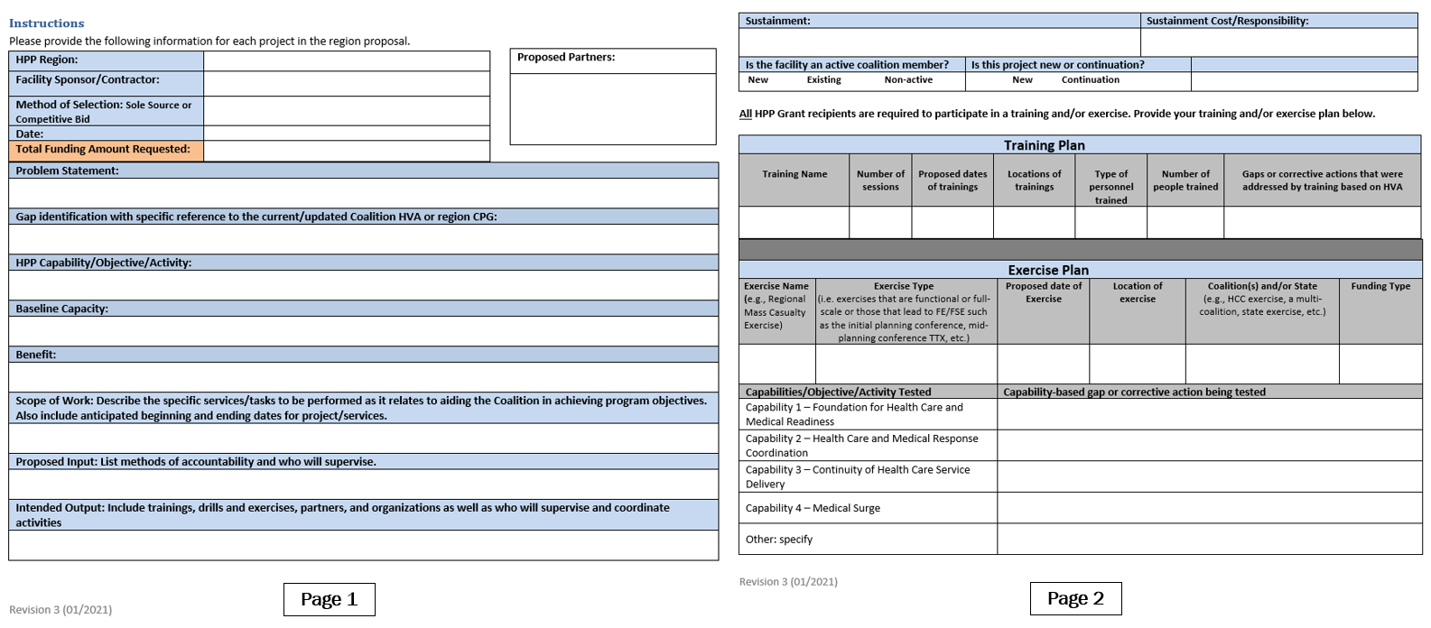
Project Proposal Form
Please reference your handouts

Slide 21
Project Proposal Line Items Page 1 (1 of 3)
Proposed Partners
Facilities participating in this project
Facility Sponsor/Contractor
Facility requesting the funds
Method of Selection: Sole Source or Competitive Bid
Sole Source: item must be purchased from a specified vendor
Competitive Bid: multiple vendors or service providers to submit offers for a material or service
Total Funding Amount Requested
Total cost for project listed on proposal

Slide 22
Project Proposal Line Items Page 1 (2 of 3)
Problem Statement
Define the planned activity/problem statement the region seeks to resolve with HPP funds during the project period
Gap Identification
Was the activity/issue identified as a gap in the region HVA or region Capabilities Planning Guidance?
If no, how was the activity or issue identified?
HPP/Capability/Objective/Activity
List the appropriate HPP/Capability/Objective/Activity the project will address
Baseline Capacity
Specify the current baseline capacity in this region
Benefit
How will this project enhance the region’s ability to serve the community and the healthcare system in the region?
Notes:
Gap Identification
The gap for the project should be illustrated in the HCC Gap listing, other projects may be approved but face deeper scrutiny at all levels.
HPP/Capability/Objective/Activity
These must match the project proposal in areas such as Gap, Justification, Outcome etc. Refer to the handouts - 2017-2022-healthcare-pr-capablities (detailed version) and the Brief HCC Capabilities-Project Alignment Grant Period 2019-2022 (condensed version)
Baseline Capacity
Define what the HCC's current capacity is.
Benefit - Explain how the project would
Increase the capacity (add a new morgue trailer),
Add a new capacity (add a mobile O2 generator/fill station), or
Enhances the current capacity (adding radio towers to expand coverage areas).

Slide 23
Project Proposal Line Items Page 1 (3 of 3)
Scope of Work
List the specific activities the region will undertake including estimated start and end dates that will lead to the associated output and contribute to resolving the identified issue or problems
Proposed Input
Describe how the progress and performance of the contractor for this project will be monitored during and on close of the contract period. Identify who will be responsible for monitoring and supervising this project and contract.
Intended Output
List the proposed outputs that will be produced as a result of the planned activities, such as a plan/SOP, training outcomes, etc. Identify who will be responsible for monitoring and supervising this project and contract
Notes:
Scope of Work – (Detailed description of the project)
As Example, if the project was training then what shall be covered, what are the learning objectives, will be lecture or a mix of hands-on and lecture, will it demonstrate improvement of skills of knowledge, will it provide and tools, will it require any consumable or special training items, will it be performed by a vendor company or by coalition members, will it cover print material, devices, or meals, etc...
The goal is to be as detailed and inclusive as possible while being as succinct as needed.

Slide 24
Is in an Input or an Output?
  Inputs are what/who will be needed to implement a project or other method for tracking project status
    Bus needed to field one of our AmbuBus Units, to be supplied by City of Oakline - Dept of Education as part of this project
        Town of Acorn will be the primary procurer of the AmbuBus kits
        New Media Center will provide training of all staff tasked with setup and use as well as develop the ongoing training on the HCC asset
  Outputs are often confused with Outcomes
  Outputs deal with the scope of the project and what marks it as complete; Outcomes deal with what change a project will bring about.
        Output – This project will secure and provide the equipment to provide one (1) specialty ambulance bus for wheelchair evacuations where wheelchairs are dominant method of patient movement/mobility.
        Outcome – Completion of this project is designed to provide the HCC region with additional resources for evacuation, raising the capacity by 50% and reducing the resource gap to sustainability

Slide 25

Justification
Justification is not on the worksheet, but it is built by the entire worksheet, to provide budgetary validation to Advisory Council and ASPR. It outlines WHY something is needed.
This element is often a critical part of a project's acceptance and approval. This means every response section should be as complete as possible.

Slide 26
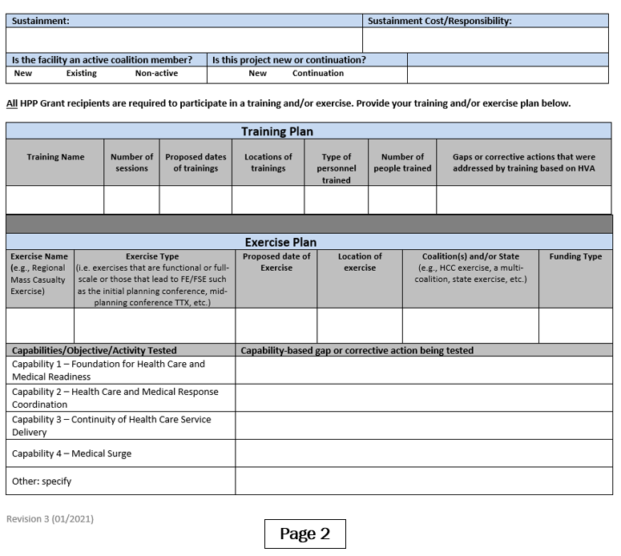
Project Proposal
Page 2
Notes:
Sustainment: How will the project be maintained in future years? If project has a shelf life, what is the expected useful life span?
Sustainment cost: What is the cost and periodicity to maintain the project? Who is responsible?
Training Plan Discussion
Exercise Plan Discussion

Slide 27
Submission Examples
Example of a good project:
Handouts 1 and 2
Example of a poor project:
Training: leads to a myriad of questions and does not effectively document the actual project
Direct benefit procurement such as fixed equipment only useable by a single entity or something that does not directly enhance the coalition or its response
Note – equipment to support an HCC plan, such as communications plans are acceptable BUT partner facilities should strive to contribute their part via match to increase sustainability

Slide 28
Midlands Healthcare Coalition
Please contact your HPP Coordinator with any questions
Michele Rowell, Midlands HPP Coordinator
rowellmd@dhec.sc.gov
Desk (803) 576-2756
Mobile (803) 430-3563

